Slide 1
CP3402 / CP5637 Content Management Systems
Week 02
CMS overview

Slide 2
Learning Objectives
Appraise the role of content management technologies to organise and present web content
Examine installation and maintenance considerations for modern websites
Introduce benefits of CMSs over static sites as well as how to run dynamic sites and CMSs locally

Slide 3
Static vs. Dynamic Websites

Slide 4
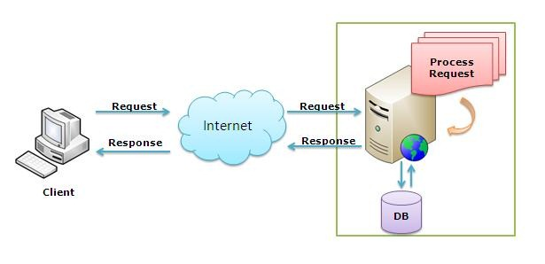
‘Static’ websites (non-CMS)
Client gets the file they request
Developer must change the file manually to update (content)
What problems does this cause?
Image source: http://www.codeproject.com/Articles/114910/What-is-the-difference-between-Web-Farm-and-Web-Ga
Notes:
Easy but limited, very manual, out of date content, authors need to know HTML and FTP to update site…

Slide 5
‘Dynamic’ websites
Server creates the page the client requests for each view
Content can be customised dynamically – from database
What problems does this cause?
Image source: http://www.codeproject.com/Articles/114910/What-is-the-difference-between-Web-Farm-and-Web-Ga
Notes:
More work, takes more time (page has to load on the server before being delivered to the client), but allows for much more: dynamic/custom content, automatically updated (not out of date), easier to update, multiple authors - don't have to learn how to edit HTML and use FTP…

Slide 6
Custom dynamic sites
Program from scratch:
Database, queries
User registration
Content presentation
Create, Read, Update, Delete (CRUD) for content
Interactive functionality: commenting, voting, sharing…
Many sites need much the same functionality, so…
Don’t reinvent the wheel

Slide 7
Content Management Systems
“a computer application that allows publishing, editing, modifying, organizing, deleting, and maintaining content from a central interface. Such systems of content management provide procedures to manage workflow in a collaborative environment… a bundled or stand-alone application to create, deploy, manage and store content on Web pages” – good old Wikipedia :)
Notes:
CMSs have been available since the late 1990s.

Slide 8
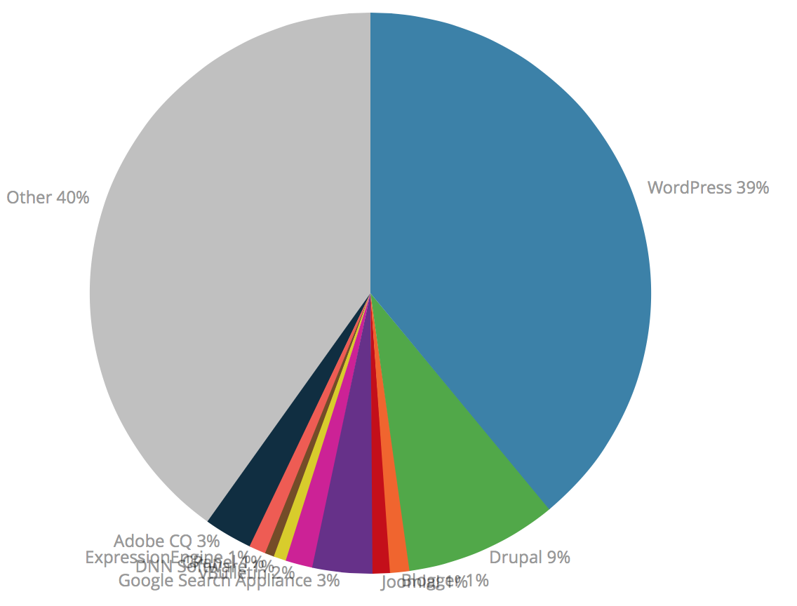
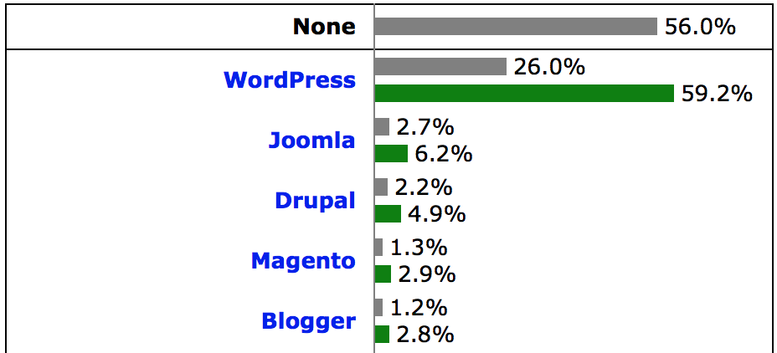
Top 3 CMSs
WordPress | Joomla | Drupal
Same: Free, open source, built with PHP & MySQL
Easiest to use | Middle ground | Most technical
Blog-friendly, full sites | Flexible custom sites | Complex advanced sites
https://support.rackspace.com/how-to/cms-comparison-drupal-joomla-and-wordpress/
Notes:
http://www.rackspace.com/knowledge_center/article/cms-comparison-drupal-joomla-and-wordpress
http://trends.builtwith.com/cms
http://w3techs.com/technologies/overview/content_management/all
http://cmsmatrix.org

Slide 9
Quick Demos
Vagrant Localhost: https://box.scotch.io/
Custom site (PHP & SQLite): https://github.com/lindsaymarkward/theadviceshop
Joomla: https://www.joomla.org/download.html
WordPress: https://wordpress.org/

Slide 10
Summary
There are many advantages to dynamic sites made with CMSs compared with static HTML websites, but they have more overhead and require server software to work

